Slide 1
Stock Market Analysis

Slide 2
Success Criteria
Our code should be written into psuedocode, and explained on THIS powerpoint.
Split our code into different subroutines/procedures to make it easier to maintain
Explain the input sanitisation used in our program
Explain how to maintain this code22
Explain what we can do with this information and link it to product release

Slide 3

CISCO – Background Information
CISCO is a multinational technological company with headquarters in California and is a major provider of networking hardware, software and telecommunications equipment for businesses world-wide.
Cisco provides IT products and services across five major technology areas: networking (including Ethernet, optical, wireless and mobility), security, collaboration (including voice, video, and data), data center and the Internet of things.

Slide 4
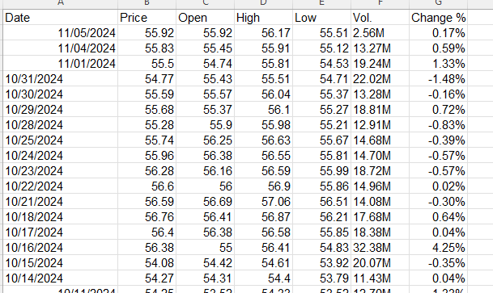
CISCO
We have downloaded the historical data of their stock for the last 14 years, and we are going to analyse the candle stick patterns on the next slide.

Slide 5
Meaning of Labels in the .csv
Price – The price of the last sale of the day, therefore the closing price.
Open – The price which the stock opened at on that day.
High – The highest price which a stock was sold for that day.
Low – The lowest price for which a stock was sold for that day.
Volume – The total amount of money made that day.
Change % - The percentage change from the previous day.

Slide 6
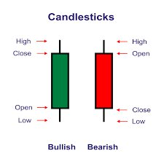
Explanation of candlesticks
Bullish (price increases) -
Open price is below the close price.
Bearish (price decreases) -
Close price is below open price.
The lines with high and low are referred to as the shadows and you can think of this as a box plot without its median value.

Slide 7

Three White Soldiers (3-day pattern)
The pattern consists of three consecutive long candles that open within the previous candle's body and close higher, indicating strong buying pressure and a shift to bullish control.
Candle 1: Open1, Close1, High1, Low1
Candle 2: Open2, Close2, High2, Low2
Candle 3: Open3, Close3, High3, Low3
Close>Open for all candles.
It is a progressive increase so close2>close1 and close3>close2.
Open Within Previous Body: Open2 > Open1 and Open2 < Close1 (Candle 2 opens within the body of Candle 1)
Open3 > Open2 and Open3 < Close2 (Candle 3 opens within the body of Candle 2)
Close Near High - Close1 ≈ High1 etc

Slide 8
Why do these patterns occur?
The Three White Soldiers pattern happens when buyers take control after a price drop, causing the price to rise steadily for three days. It shows that the market is turning from negative to positive, with more people wanting to buy than sell.
The Dark Cloud Cover candlestick pattern occurs when a strong upward trend is interrupted by a sudden bearish reversal. It forms because sellers gain strength after a price rise, pushing the price down and closing below the midpoint of the previous bullish candle. This shift shows that market sentiment may be turning negative, with buyers losing control to sellers.
The Shooting Star candlestick pattern occurs when the price rises sharply during the session but faces strong selling pressure, pushing it down to close near its opening price. This shows that buyers tried to push the price higher, but sellers regained control, signaling a potential reversal from bullish to bearish sentiment.

Slide 9
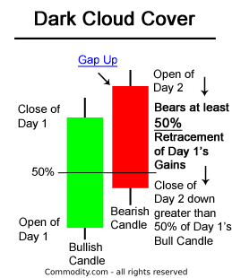
Dark Cloud Cover (2-day pattern)
This pattern suggests that the buying pressure from the first candle has weakened, and sellers are starting to take control, signaling a possible trend reversal to the downside. Dark cloud cover usually occurs after an uptrend and the second candle should be halfway into the body of the first candle. Bullish to Bearish.
This is useful as Cisco is innovative so when a new product launches ,there could be initial hype and sales increase .
Candle 1: Open1, Close1, High1, Low1
Candle 2: Open2, Close2, High2, Low2
Bullish First Candle: Close1 > Open1
Bearish Second Candle: Close2<Open2
Second Candle Opens Above First Candle’s High: Open2 > High1
Second Candle Closes Below the Midpoint of the First Candle: Close2 < (Open1 + Close1) / 2

Slide 10
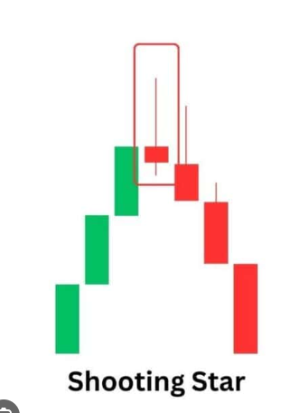
Shooting Star (1-day pattern)
It signals that the price may have reached a temporary peak and could be about to reverse or decline. The pattern gets its name because the long upper shadow looks like a shooting star, and it suggests that the market’s bullish momentum may be fading.
Bullish Candle (Open < Close): Close>Open
Long Upper Shadow (Upper Shadow ≥ 2 × Real Body): High−max(Open,Close)≥2×∣Close−Open∣
Small Real Body (Body ≤ 30% of Total Candle Height): ∣Close−Open∣≤0.3×(High−Low)
Little or No Lower Shadow: Low≈min(Open,Close)

Slide 11
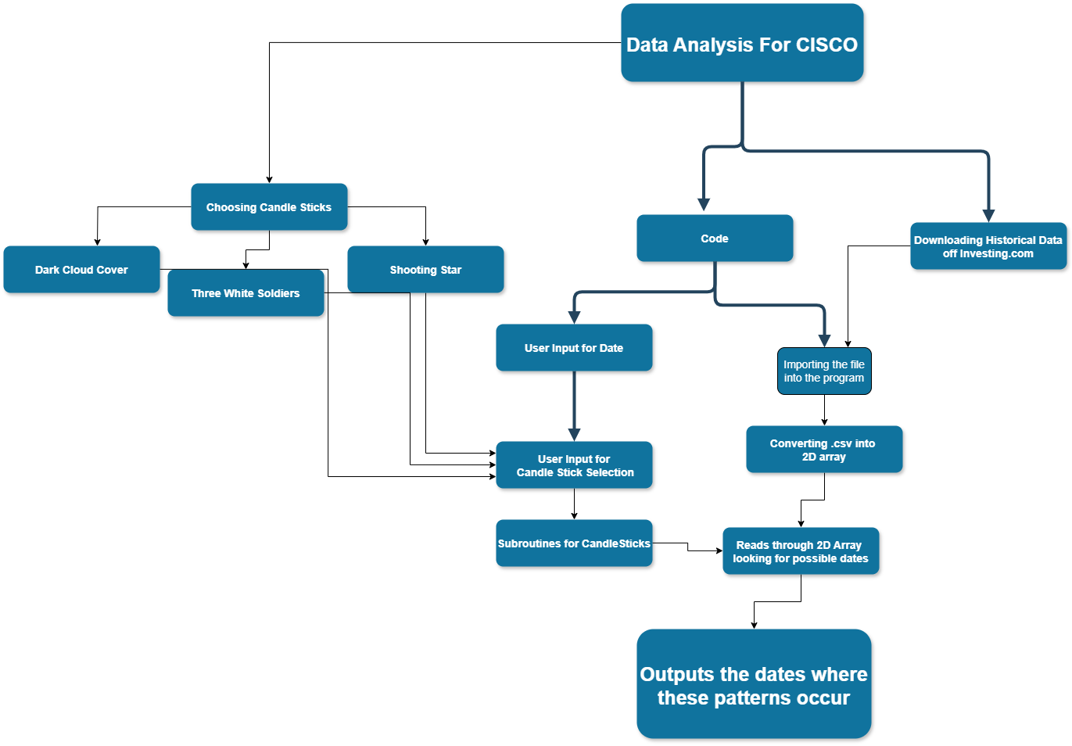
Top-Down Level Design

Slide 12
Errors / Difficulties during the coding
Had to figure out how to convert the .csv into a 2d array
Dates could not be formatted so we had to import a library, so it makes it easier (DateTimeFormatter)
Date input sanitisation was difficult without an exception handler
Data in the 2d array couldn’t be converted into integers or strings as they were in speech marks, therefore had to remove speech marks
Had to figure out how to code the math for each candle stick pattern
When searching through the array, some patterns couldn't be found due to an error in the code
The console output did not stick out, so we made it bold.

Slide 13
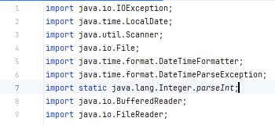
Libraries
Process

Slide 14
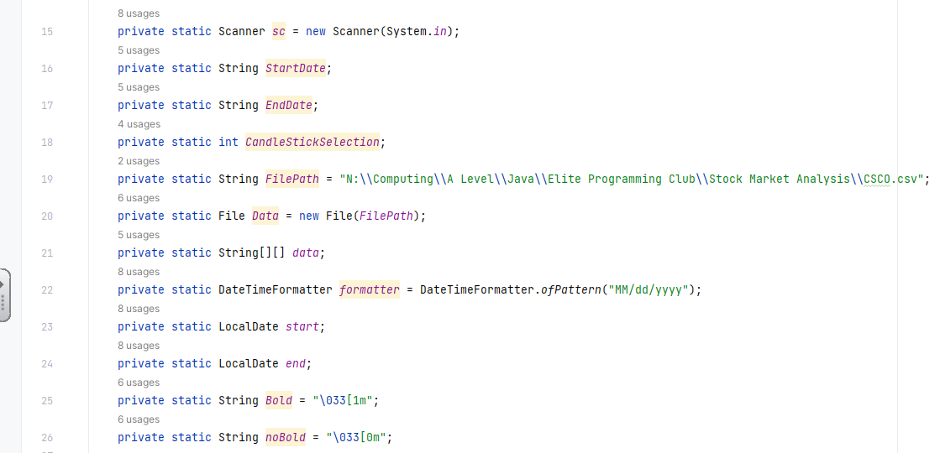
Global variables
Process

Slide 15
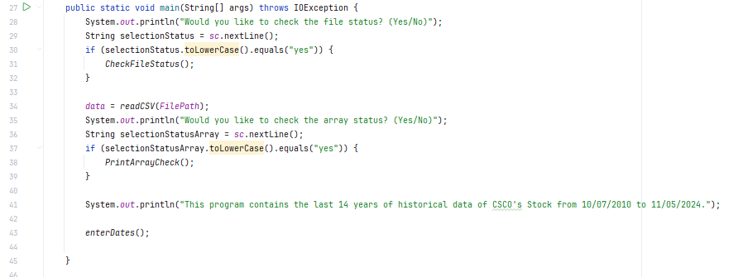
Main
Code asks whether user wants to check the file status and array status of the .csv file, and then specifies the date range followed by the enterDates procedure being called for user input of dates
Java Techniques :
Selection
Subroutines
Exception Handler (for runtime errors)
Input / Process

Slide 16
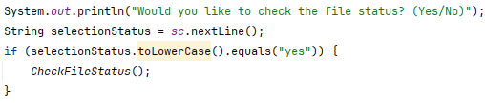
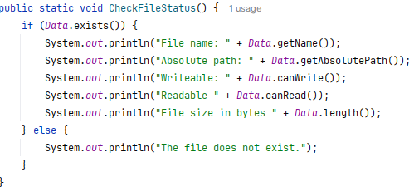
File is read into the java program / Status Checker
File path declared as a global string, and file is also read into java, subroutine for user to check file status (whether its available or not)
Java Techniques:
File I/O
Selection
Subroutines
process

Slide 17
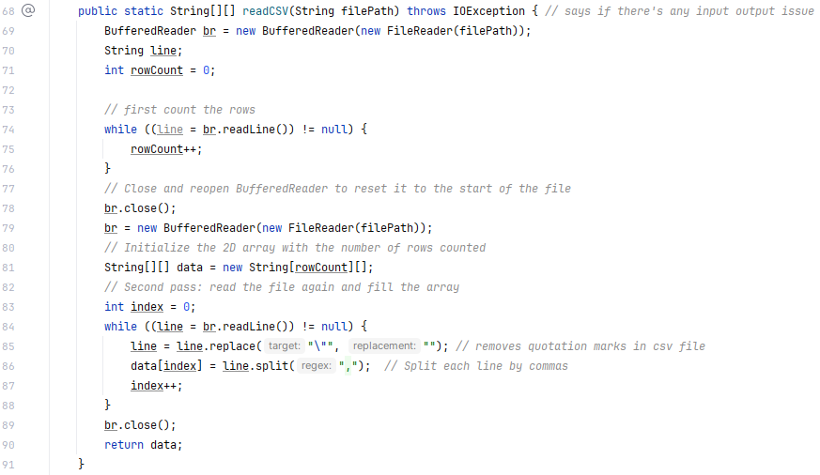
Convert .csv into a 2D array (removing speech marks)
Using Buffered Reader to convert the .csv file into a 2D array. The .csv file has data in speech marks so line.replace (line 65) is used to get rid of the speech marks.
Java Techniques:
Subroutines
Iteration
File I/O
Arrays
Process

Slide 18
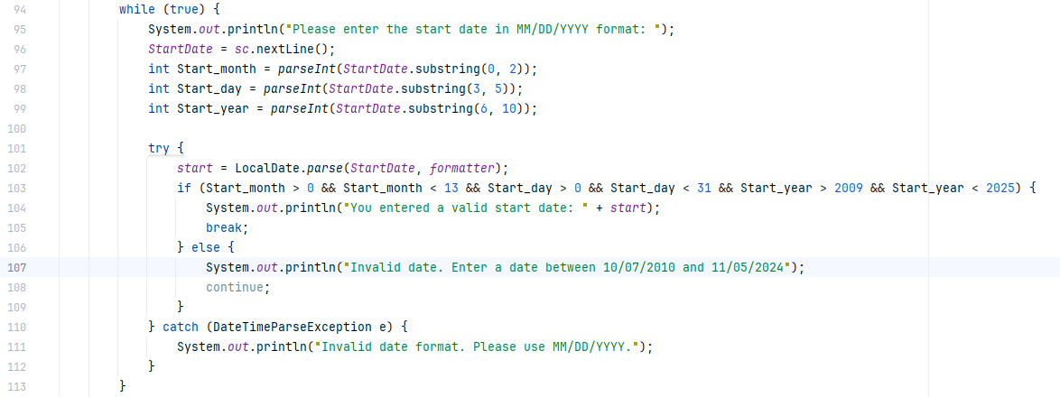

Start Date Input Set
Java Techniques:
Exception Handler
Selection
Iteration
Subroutines
Date is prompted to be inputted in the form MM/DD/YYYY, this string is then manipulated and split into month, day and year to check whether it is a valid input. The date formatter is used to make sure it is in the correct form to be used to search through data.
Input

Slide 19
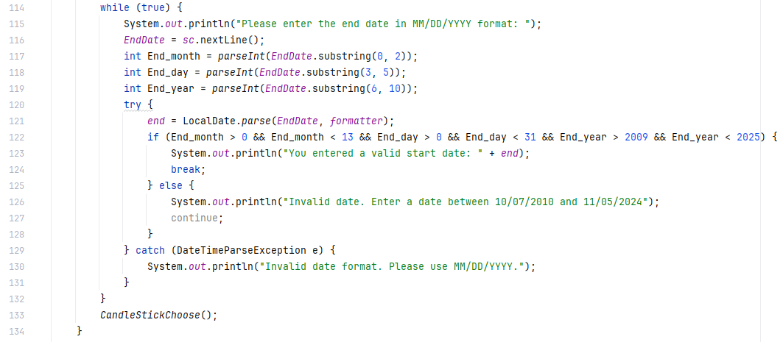
End Date Input Set
Java Techniques:
Exception Handler
Selection
Iteration
Subroutines
Date is prompted to be inputted in the form MM/DD/YYYY, this string is then manipulated and split into month, day and year to check whether it is a valid input. The date formatter is used to make sure it is in the correct form to be used to search through data.
Following the inputs of the dates the subroutine CandleStickChoose is called.
Input

Slide 20
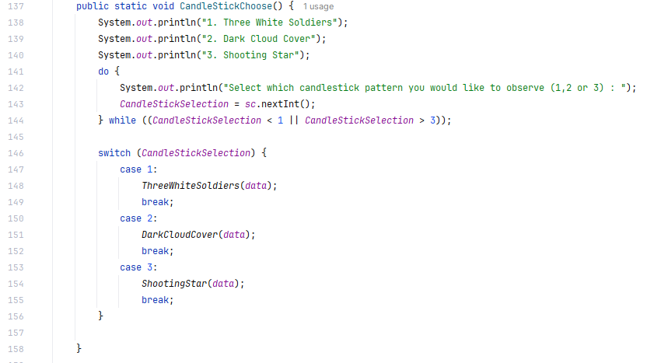
Candle Stick Selection
The three options for candle stick patterns are displayed and the user picks one to analyse using the dates inputted before
Java Techniques:
Selection
Iteration
Subroutine
Input / Process

Slide 21
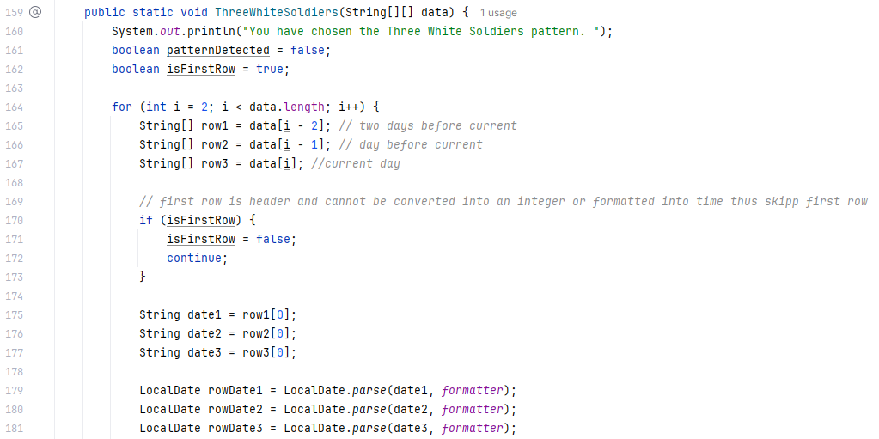
Three White Soldiers
Iterates through the 2D Array (Data) and intitialises three rows, for three consecutive days. The first row is skipped as it's the header and the first element of the rows are the dates which are formatted into MM/DD/YYYY to be compared with the dates entered by the user.
Java Techniques:
Arrays
Iteration
Selection
Subroutines
process

Slide 22
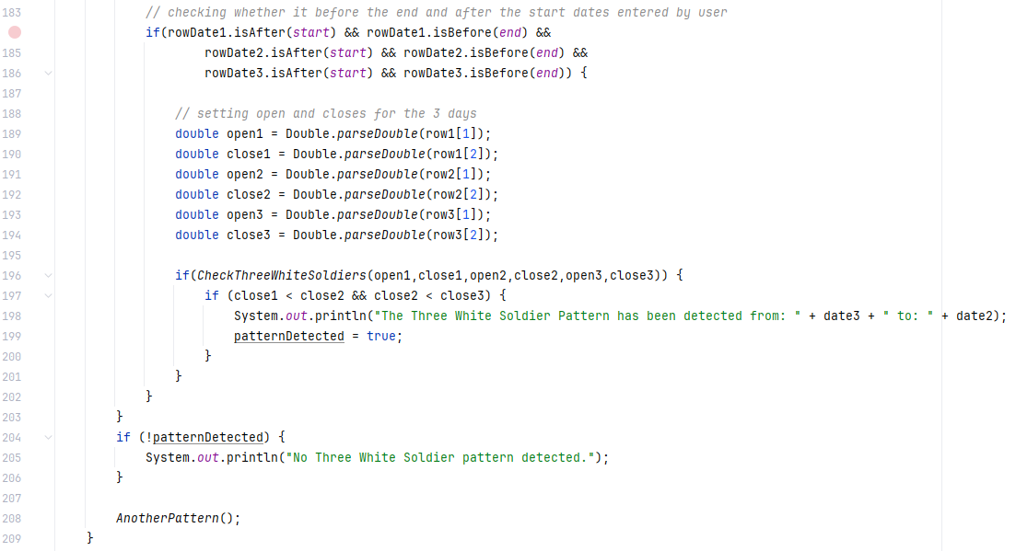
Three White Soldiers
The being iterated dates are compared with user inputted dates and if they are in between the range then variables for the opens and closes of the three days are initialised and passed into the function CheckThreeWhiteSoliders, if this the boolean is returned as true, the date ranges are outputted, but if not, it says no pattern detected.
Java Techniques:
Subroutines
Arrays
Selection
Iteration
Process / Output

Slide 23
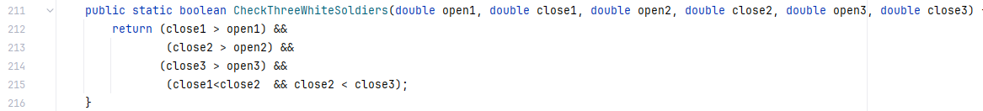
Three White Soldiers
If the close is greater than the open (bullish) and each close is less than each other, then Three White Soldiers is detected and will be returned as true.
Java Technique:
Selection
Subroutine
Process

Slide 24
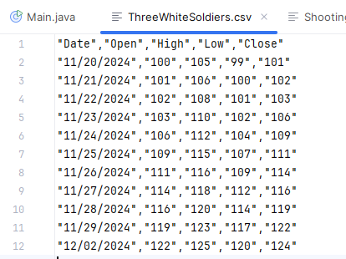
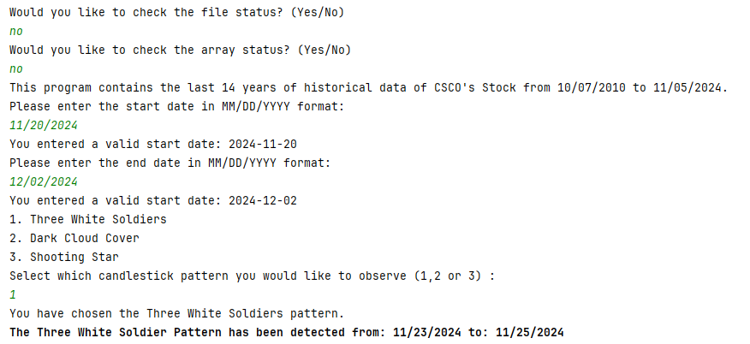
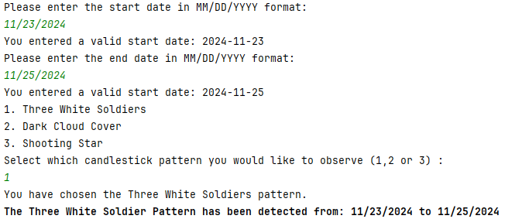
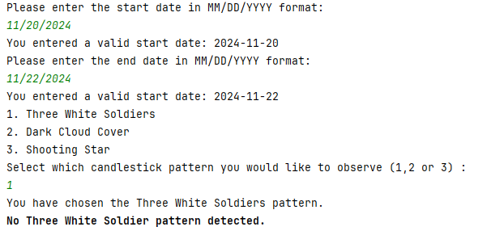
Testing Three White Soldiers:
Normal
Boundary
On 11/23/2024, the first bullish candle appears:
The open is 103, and the close is 106, indicating a strong upward movement.
On 11/24/2024, the second candle is a bullish one:
The open is 106, and the close is 109, which is higher than the previous close (106).
On 11/25/2024, the third candle is also bullish:
The open is 109, and the close is 111, confirming that the price is continuing to rise, showing strength in the uptrend.
Erroneous

Slide 25
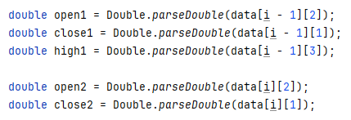
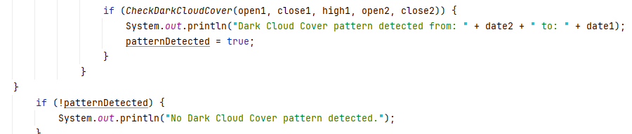
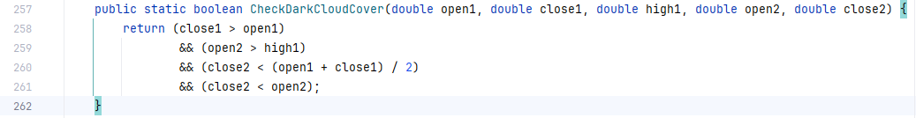
Dark Cloud Cover
The same code is used as the one before for Dark Cloud Cover but instead of comparing three rows, it compares two rows. It uses the open, close and high of day 1 and open and high of day two.
These values are then passed into the function CheckDarkCloudCover:
If day 1 candle is bearish; the open of day 2 is greater than the highest of day 1; the second candle closes the midpoint of the first and the close is less than the open, it returns true, outputting the date range.
Java Techniques:
Iteration
Subroutines
Arrays
Selection
Process / Output

Slide 26
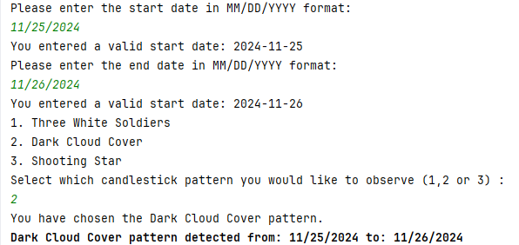
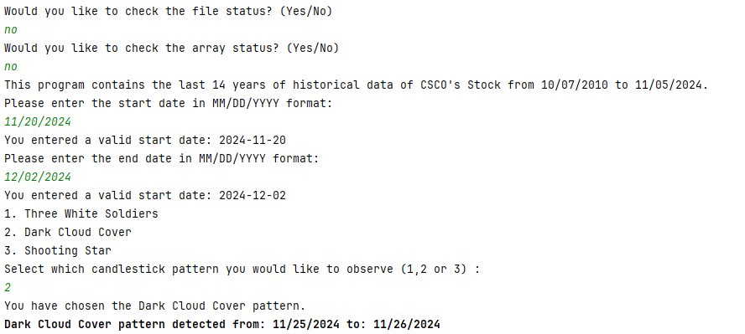
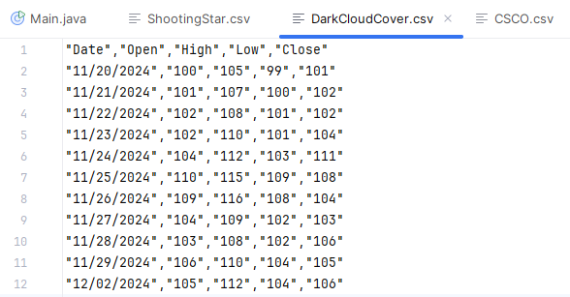
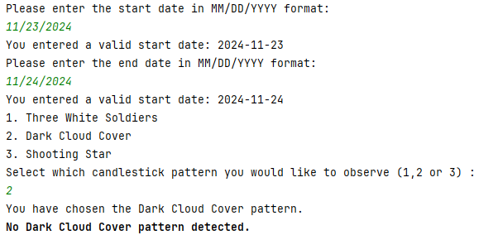
Testing Dark Cloud Cover
boundary
normal
Dark Cloud Cover is on 11/26/2024 as:
On 11/25/2024, the candlestick forms the first part of the pattern:
The open is 110, and the high is 115, indicating strong upward movement.
The close is 108, still above the open, showing a bullish close.
On 11/26/2024, the second candle forms:
The open is 109, higher than the previous close (108), but it opens above the high of the previous candle (115).
The close is 104, which is more than halfway into the body of the previous white candle (111), forming the dark cloud cover.
erroneous

Slide 27
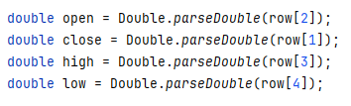

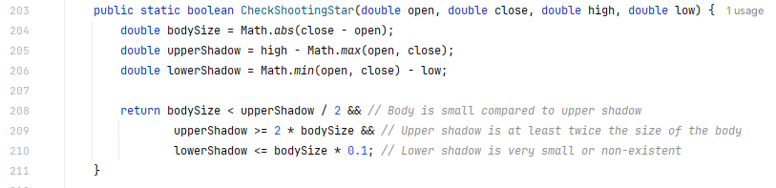
Shooting Star
Process / Output
The same code is used as the ones before for Shooting Star but instead of comparing three or two rows, it compares 1 row' s open, high, close and low.
These values are then passed into the function CheckShootingStar:
BodySize is the absolute (always positive) value from close-open
UpperShadow is the high subtracted from what is bigger between open and close
LowerShadow is smaller value between the open and high taken away from the low
If the BodySize is less than half the UpperShadow; the upper shadow is greater than twice the BodySize and the LowerShadow is very small or non-existent, true is returned and the date where this occurs is outputted
Java Techniques:
Iteration
Subroutines
Arrays
Selection

Slide 28
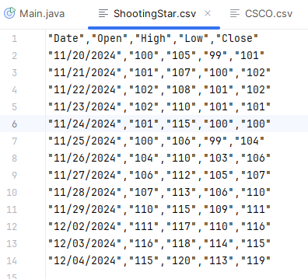
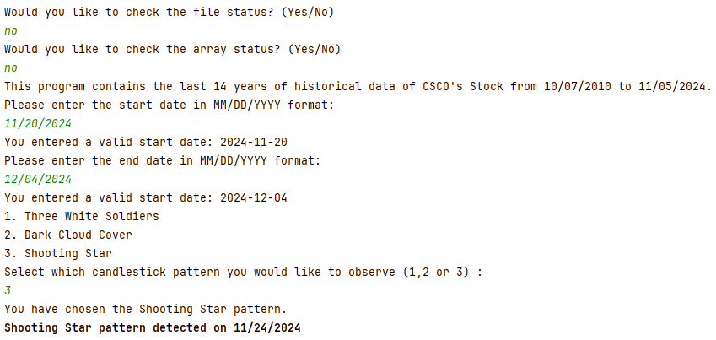
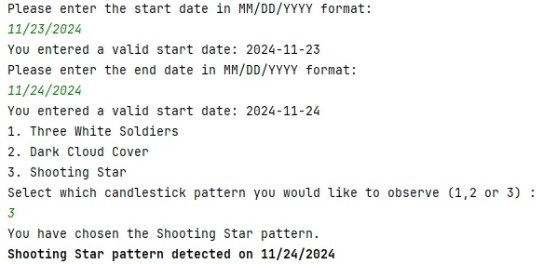
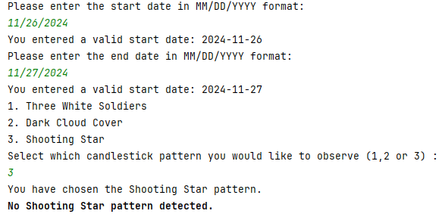
Testing Shooting Star
normal
Boundary
Shooting Star is on 11/24/2024 as:
The open price is 101.
The high price reached 115, significantly higher than the open.
The low price is 100, very close to the open, showing the price fell back after hitting the high.
The close price is 100, which is near the open, confirming a small body at the bottom.
Erroneous

Slide 29
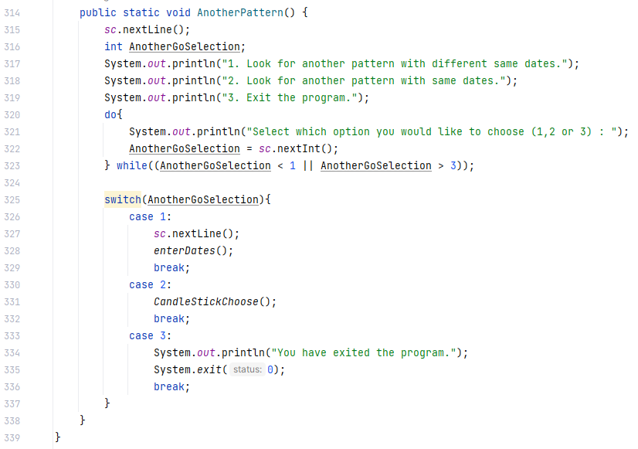
Can check another pattern after one done
Subroutine called after each output of dates where pattern occurred for what to do next
Java Techniques:
Selection
Subroutine
Iteration
Input / Process

Slide 30
Maintenance of the code:
Meaningful names of identifiers/subroutines
Comments on some bits to understand what it does
Readable / Indented
Well Structured

Slide 31
WWW
The code works.
The code is easy to understand
Code is <350 lines of code
We understand how to analyse candle sticks

Slide 32
EBI
Planned better prior to coding (psuedocode)
More years of data to be analysed
Found out why these occurred on the particular dates

